Slide 1
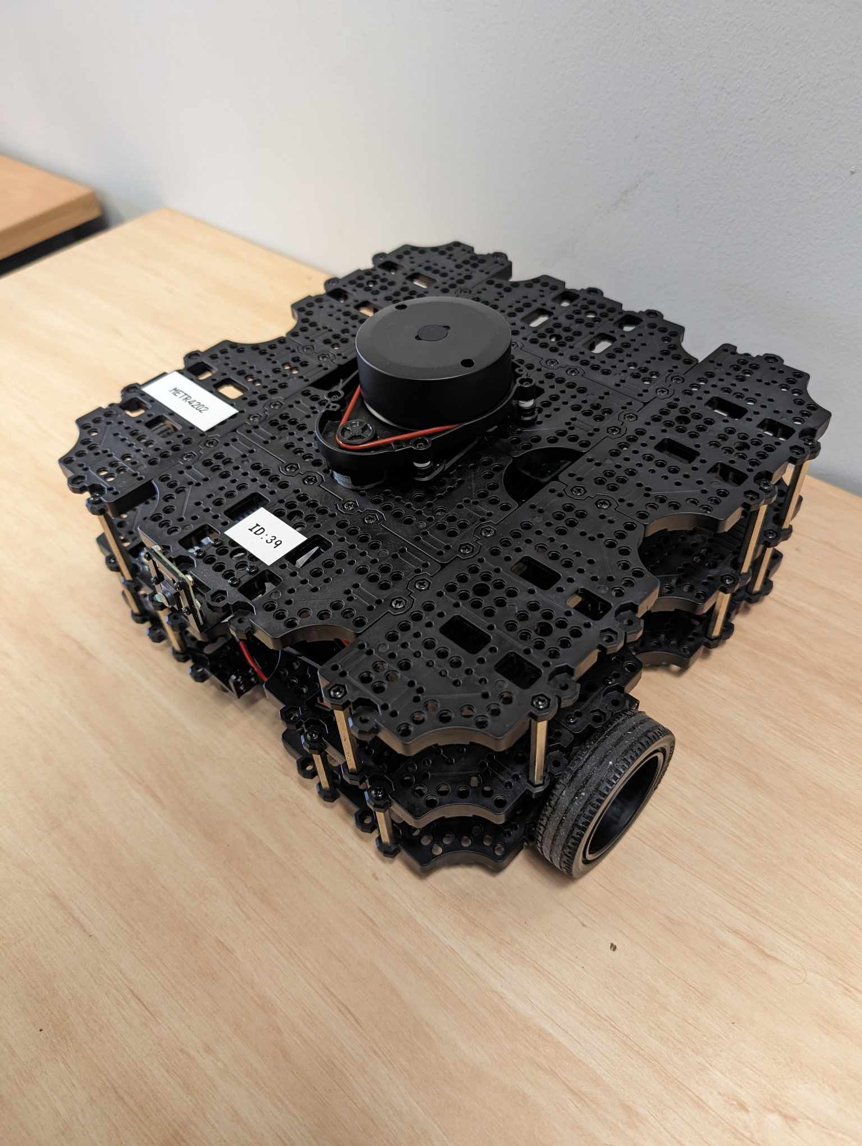
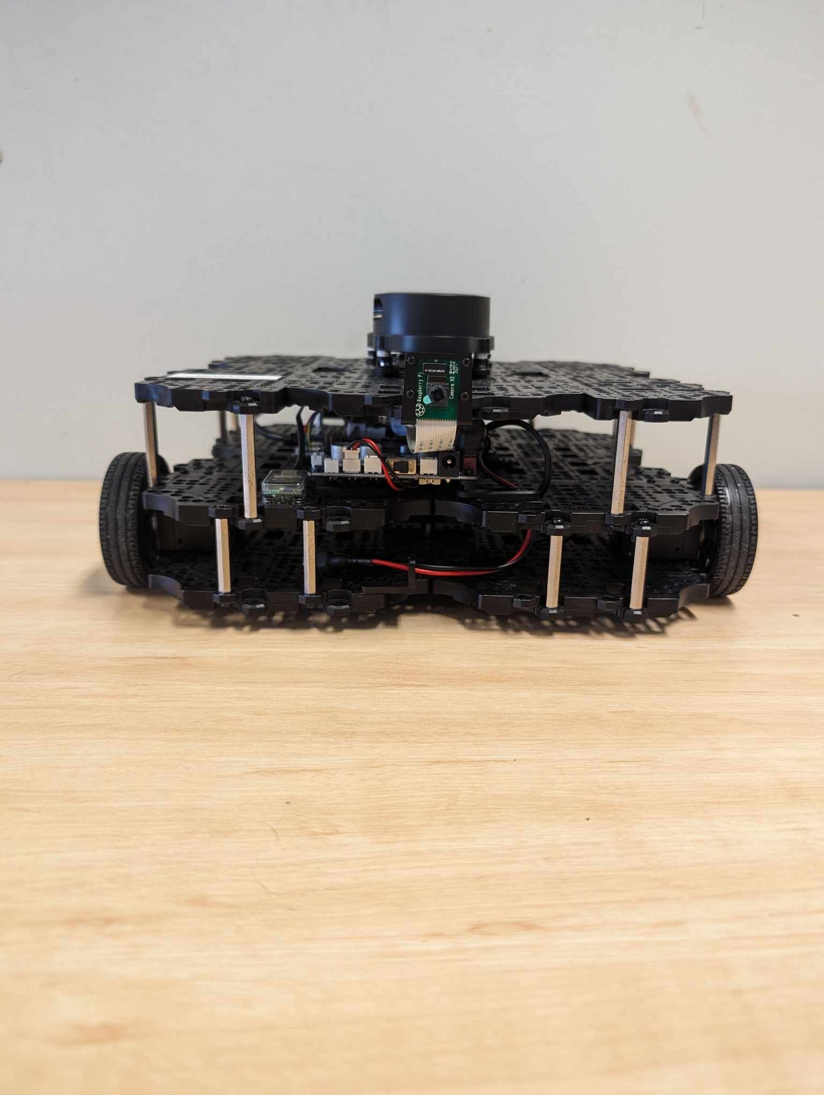
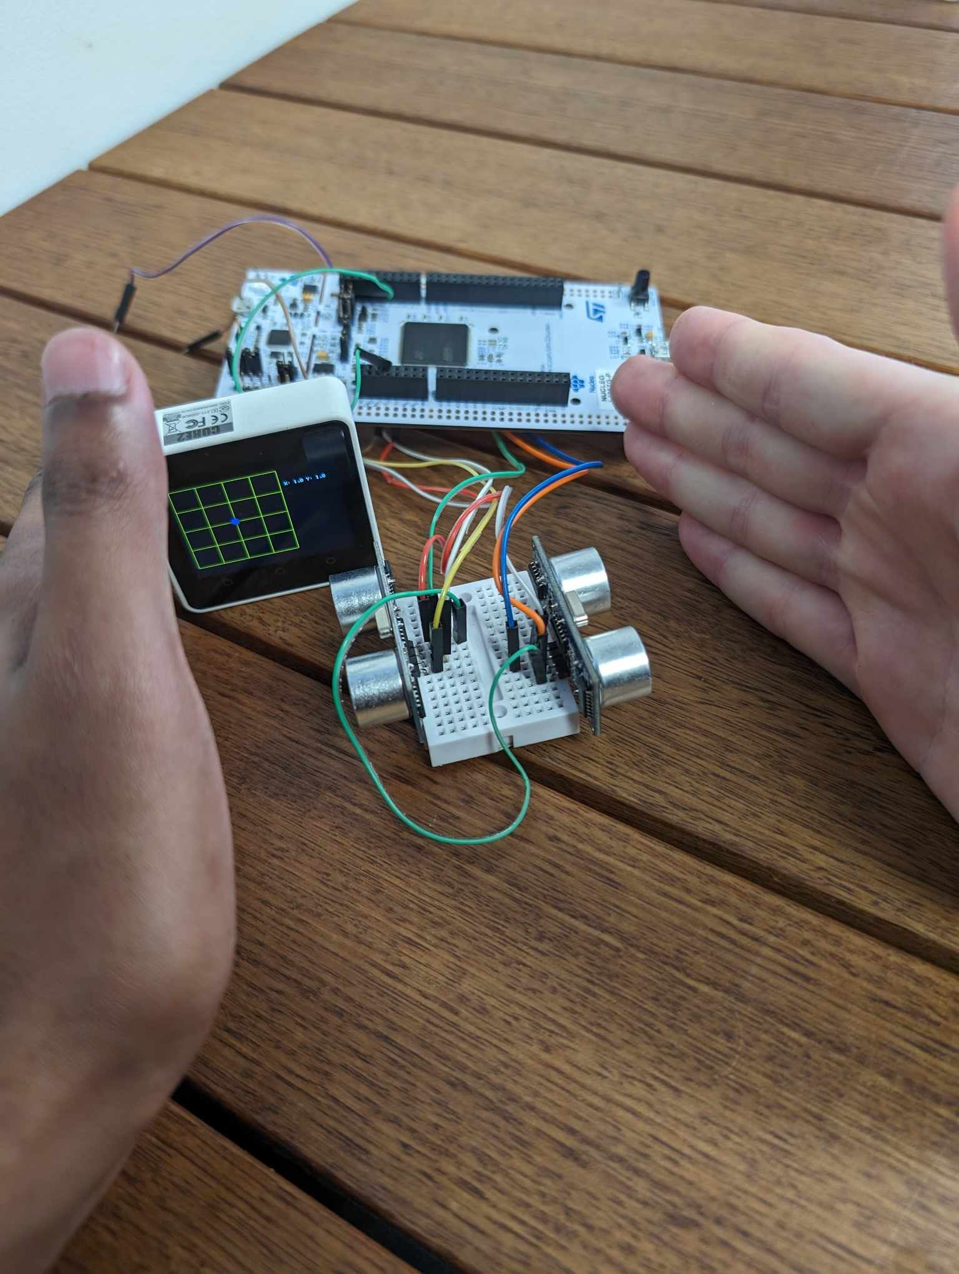
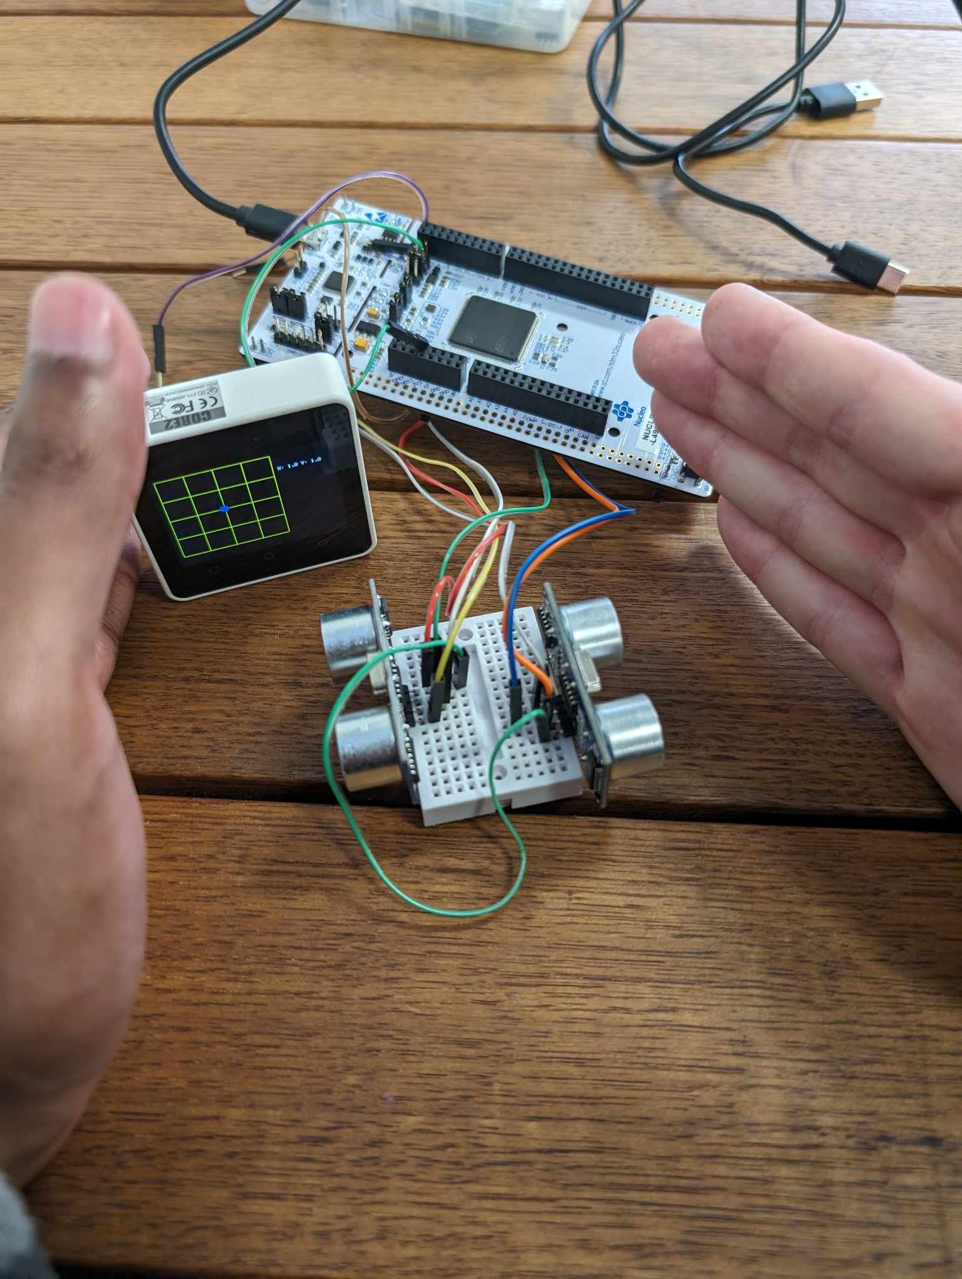
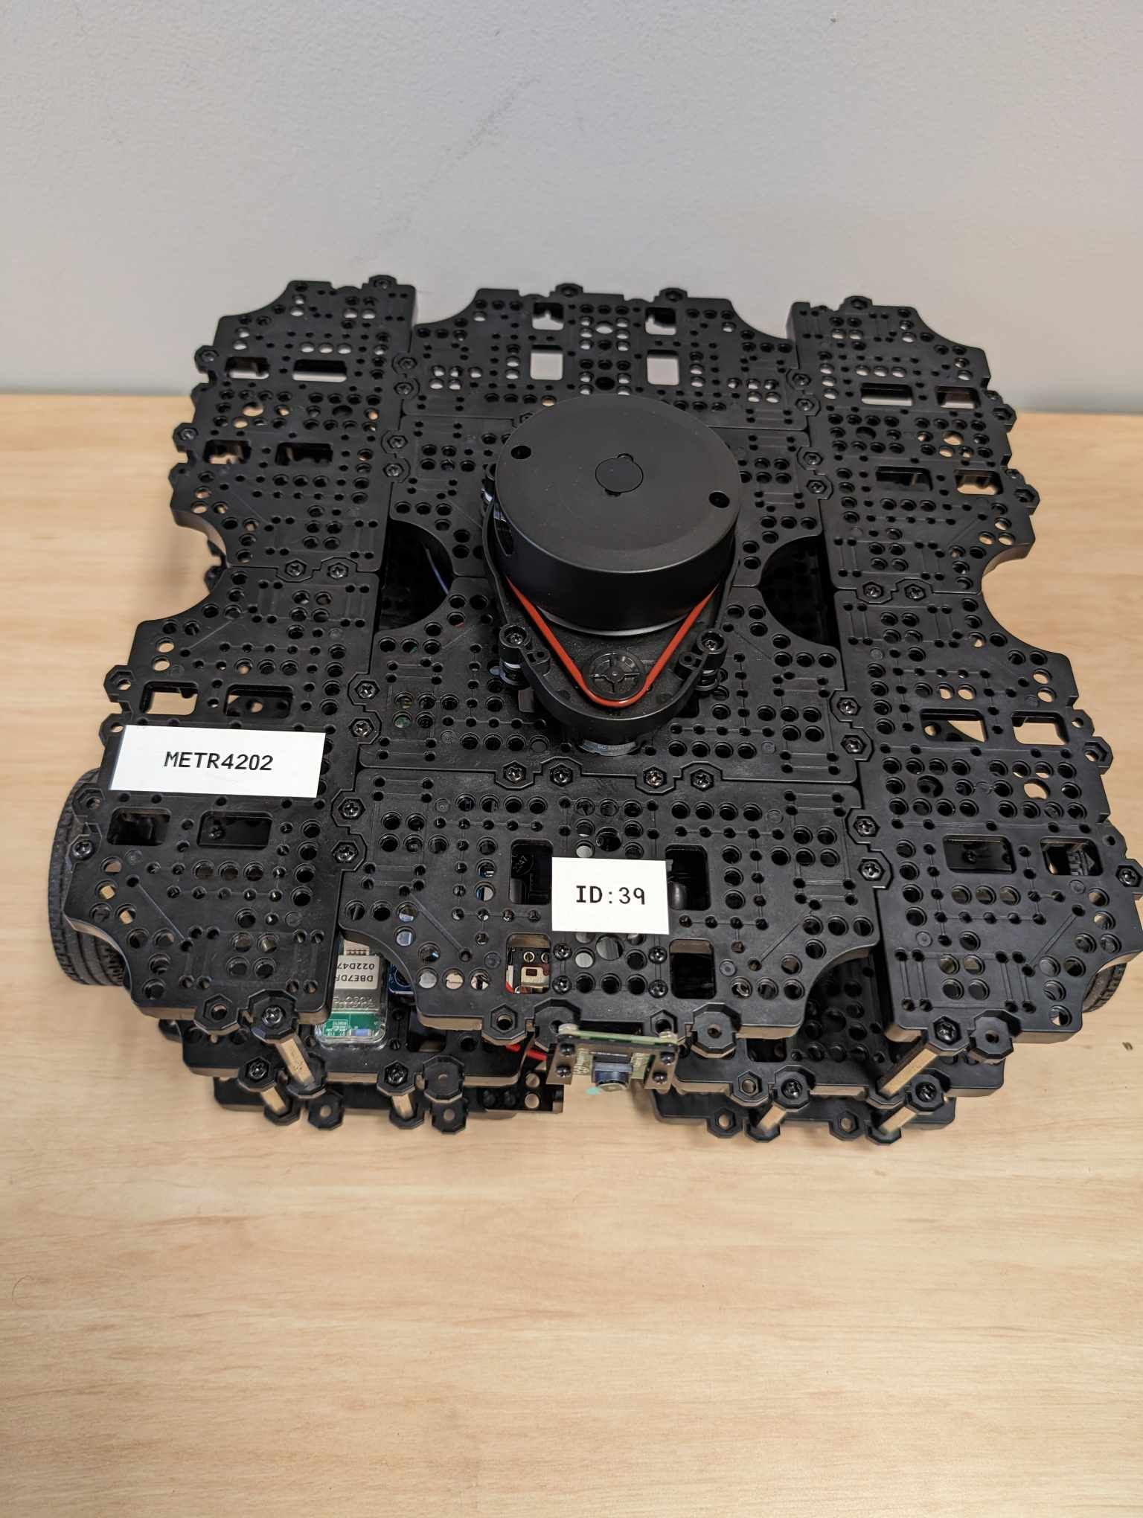
TurtleBot controlled by Ultrasonic (Variation of Fe.2)
Ethan Laskowski, Henry Sommerville, Mark Kandathiparambil, Deklan Scholler Uranus-Crimson
SYSTEM OVERVIEW:
Controlling a TurtleBot by ultrasonic proximity
TurtleBot gesture controlled
MQTT communication between m5core2 and TurtleBot
Ultrasonic sensors connected through UART to nucleo board
AIMS:
TurtleBot movement controlled by ultrasonic sensors
Ultrasonic sensors can be utilized as gesture controllers that affect the TurtleBot
TurtleBot’s position can be tracked and displayed on the m5core2
TurtleBot utilizes the LiDAR to enhance position detection
TurtleBot can communicate with the m5core2 and display its position
TurtleBot has some autonomous functionality such as reaching the end of the grid and stopping
RESULTS:
TurtleBot can be controlled via the ultrasonic sensors.
Ultrasonic sensors can be used to detect gestures.
The m5core2 can communicate to the TurtleBot via MQTT.
The m5core2 can display the TurtleBot’s position on its display.
The LiDAR can be utilized to track the TurtleBot’s position.
Gestures identified from the ultrasonic sensors cause a movement change in the TurtleBot
When reaching the grids edge the TurtleBot stops and turns
CONCLUSIONS:
Achieved the TurtleBot can be controlled and moved through ultrasonic sensors
Achieved the TurtleBot’s position can be tracked and displayed on the m5core2
Achieved that the TurtleBot can communicate with the m5core2 and display its position
Achieved that the TurtleBot utilizes the LiDAR to enhance position detection
Achieved that the ultrasonic sensors can be utilized as gesture controllers that affect the TurtleBot
Achieved TurtleBot has some autonomous functionality such as reaching the end of the grid and stopping

